Slide 1
Algorithms & Data Structures
Graph BFS
Notes referred from Prof Anish Maturia’s lectures

Slide 2
Graph Topics
Representation of graphs
Breadth-first search
Depth-first search
Topological sort
Single-source shortest paths
Finding minimum-spanning trees
Main reference: Introduction to Algorithms, Cormen, Leiserson, Rivest, Stein (CLRS)
22.1-22.4
24.1-24.2
23.1-23.2

Slide 3
Undirected Graph
This is a undirected graph (V, E) where there are 5 vertices 1, 2, . . . , 5
and 7 edges. Note that edges do not have direction which means vertices on both end can be reached using the same edge.
for instance, using an edge between 1 and 2, you can reach vertex 2 from 1 or vice a versa.

Slide 4
Directed Graph
This is a directed graph (V, E) where there are 5 vertices v1, v2, . . . , v5,
and 7 edges e1, e2, . . . , e7. Note that every edge has a direction. Edge e6,
for instance, is an outgoing edge of v5, and an incoming edge of v4.

Slide 5
Directed Graph
A directed graph is a pair (V, E) where
V is a set of elements, each of which called a node
E is a set of pairs (u, v) where u and v are nodes in V. We say that there is a (directed) edge from u to v.
A node may also be called a vertex. We will refer to V as the vertex set or the node set of the graph, and E the edge set.
A (directed) edge (u, v) is said to be an outgoing edge of u, and an incoming edge of v. Accordingly, v is an out-neighbour of u, and u an in-neighbor of v.

Slide 6
Directed Graph: Degrees
In a directed graph, the out-degree of a vertex u is the number of outgoing edges of u, and its in-degree is the number of its incoming edges.
In the graph, the out-degree of v3 is 2, and its in-degree is 1.
What is the out and in degree of v4?

Slide 7
Graph: Representation
Two common ways to store a graph:
Adjacency list and
Adjacency matrix.
In both cases, we represent each vertex in V using a unique id in 1, 2, . . . , |V|.

Slide 8
Undirected Graph Representation – Adjacency List

Slide 9
Undirected Graph Representation – Adjacency Matrix

Slide 10
Adjacency List Representation of Directed Graph
Each vertex u ∈ V is associated with a linked list that enumerates all the vertices that are connected to u. Space Complexity = O(|V| + |E|)

Slide 11
Adjacency Matrix Representation of Directed Graph
A |V| x |V| matrix A where A[u, v] = 1 if (u, v) ∈ E, or 0 otherwise.
A may not be symmetric.
Space = O(|V|²).

Slide 12
Breadth First Search in Directed Graph
We will discuss a simple algorithm – called breadth first search – to traverse all the nodes and edges in a graph once.
We will cast it in a concrete problem: single source shortest path (SSSP) with unit weights.
Graph BFS is slightly different from Tree BFS because tree does not have cycles but directed graph has cycles.

Slide 13
Shorted Path Definition
Let G = (V, E) be a directed graph.
A path in G is a sequence of edges (v1, v2), (v2, v3), . . . , (vl, vl+1), for some integer l >= 1, which is called the length of the path. The path is said to be from v1 to vl+1.
Sometimes, we will also denote the path as v1 → v2 → … → vl+1.
Given two vertices u, v ∈ V, a shortest path from u to v is a path from u to v that has the minimum length among all the paths from u to v.
If there is no path from u to v, then v is said to be unreachable from u.

Slide 14
Shorted Path Example
There are several paths from a to g:
a → b → c → d → g (length 4)
a → b → c → e → d → g (length 5)
a → d → g (length 2)
The last one is a shortest path. In this case, the shortest path is unique.
Note that h is unreachable from a.

Slide 15
Single Source Shortest Path (SSSP) with Unit (1) Weights
Let G = (V, E) be a directed graph, and s be a vertex in V. The goal of the SSSP problem is to find, for every other vertex t ∈ V \ {s}, a shortest path from s to t, unless t is unreachable from s.

Slide 16
BFS in Graph
At the beginning, color all vertices in the graph white. And create an empty BFS tree T.
Create a queue Q. Insert the source vertex s into Q, and color it gray (which means “in the queue”).
Make s the root of T.

Slide 17
BFS in Graph
Suppose that source vertex is a
Q = (a)

Slide 18
BFS in Graph
Repeat the following until Q is empty.
De-queue from Q the first vertex v.
For every out-neighbor u of v that is still white:
En-queue u into Q, and color u gray.
Make u a child of v in the BFS tree T.
Color v black (meaning v is done).
BFS behaves like “spreading a virus”, as we will see from our running example.

Slide 19
BFS Example
After De-Queueing a
Q = (b, d)

Slide 20
BFS Example
After De-Queueing b
Q = (d, c)

Slide 21
BFS Example
After De-Queueing d
Q = (c, g)

Slide 22
BFS Example
After De-Queueing c
Q = (g, e) → NOTE: d is not enqueued again because it is black

Slide 23
BFS Example
After De-Queueing g
Q = (e, f, i)

Slide 24
BFS Example
After De-Queueing e, f and i
Q = ()
This is the end of BFS. Note that h remains white – we can conclude that it is not reachable from a.

Slide 25
BFS Example
What are shortest paths?
The shortest path from a to any vertex, say x, is simply the path from a to node x in the BFS tree!

Slide 26
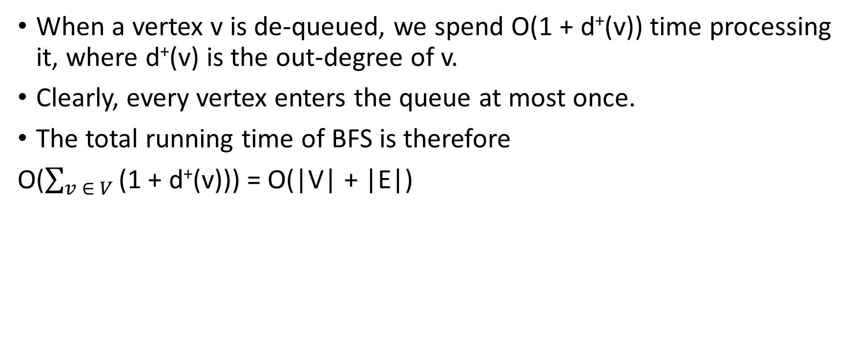
Time Complexity of BFS
When a vertex v is de-queued, we spend O(1 + d⁺(v)) time processing it, where d⁺(v) is the out-degree of v.
Clearly, every vertex enters the queue at most once.
The total running time of BFS is therefore
O($\sum_{v ∈ V}{\text{(1 + }\text{d}\text{+}\text{(}\text{v}\text{)}}$)) = O(|V| + |E|)

Slide 27
Quiz
Suppose you only have access to BFS, and cannot change the way the algorithm works, only its input. Given a graph with integer edge weights between 1 and 5 (inclusive), you want to find the shortest weighted path between a pair of vertices. How would you reduce this problem to the shortest unweighted path problem, which can be solved using BFS?

Slide 28
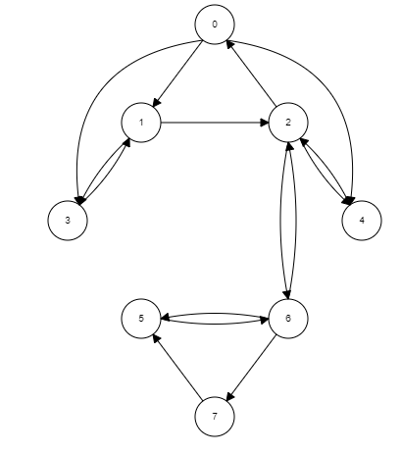
Exercise
Build the BFS tree
starting from node 0

Slide 29
Quiz
The reverse graph of a directed graph G is another directed graph G^{R} which is identical to G except that the direction of each edge in G has been reversed. In other words, if G = (V, E) is a directed graph, then G^{R} = (V, E^{R}) is another directed graph where the edge (u, v) ∈ E^{R} if and only if the edge (v,u) ∈ E.
Write detailed pseudo-code for an algorithm that takes a graph G = (V, E) as input, and produces G^{R} = (V, E^{R}) as output. Assume that both G and G^{R} are represented using an adjacency list representation.
(Do NOT assume that the neighbors of a node are organized in any particular order in the node's adjacency list.) Your algorithm should run in linear time, that is O(|V| + |E|).

Slide 30
Proof of Correctness
We will prove that BFS outputs the vertices in G (reachable from s) in ascending order of their distances from s. Let Vi (i >= 0) be the set of vertices that are i-hops away from s.
The next lemma essentially shows that BFS outputs all the vertices of Vi before outputting any vertex in Vi+1, for any possible i .

Slide 31
Proof of Correctness
Lemma: For any i , when BFS finishes outputting all the vertices of Vi , Q contains all and only the vertices of Vi+1.
Proof: We prove the lemma by induction. The basis step with i = 0 is trivial, noticing that V0 = {s}. Next, assuming that the lemma is correct up to i <= k, we show its correctness for i = k + 1. At the moment when all the vertices of Vk have been output, the inductive assumption implies:
every vertex of Vk+1 is in Q,
Q does not have any other vertex,
V0, . . . , Vk+1 have been output.

Slide 32
Proof of Correctness
It suffices to prove that when Vk+1 has been output completely, the entire Vk+2 is in Q, and Q does not have any other vertex. This is true from the following:
Consider any u 2 Vk+1. BFS en-queues only the white neighbors of u. All these neighbors must be in Vk+2.
Any vertex in Vk+2 must have at least a neighbor in Vk+1.

